Slide 1


Final Project: FaceNet2ExpNet: Regularizing a Deep Face Recognition Net for Expression Recognition
University of Tehran
Department of Electrical and Computer Engineering
Elahe Barat Vakili - Nastaran Soofi -
Mohammadreza Teymoorian Fard
Deep Learning
Dr. Reshad Hosseini
Summer 2022

Slide 2

Table of Contents
Introduction
Related Works
Algorithm and Structure
Training
Results
Suggestions

Slide 3

Introduction
Challenges with small datasets
Problems with Fine-Tuning
Propose New Distribution Function
2-Stage Training

Slide 4

Related Works
Multi task Sparse Learning Framework
Deformable Facial Part Model
Fuse two Deep Networks
Two-stage Learning

Slide 5





Algorithm and Structure
$$Expression net as O=h_{θ_{2}}\left(g_{θ_{1}}\left(I\right)\right)$$
$$Distribution function f\left(X^{l}\right)=C_{p}∗e^{−{\left|\left|x^{l}\right|\right|}_{p}^{p}}$$
$$X^{l}=\left[x_{1}…. x_{C}\right]∈R^{C}$$
$$To incorporate the Knowledge of Face Net⇒ f\left(X^{l}\right)=C_{p}∗e^{−{\left|\left|X^{l}−μ\right|\right|}_{p}^{p}}$$
$$μ=G\left(I\right)$$

Slide 6
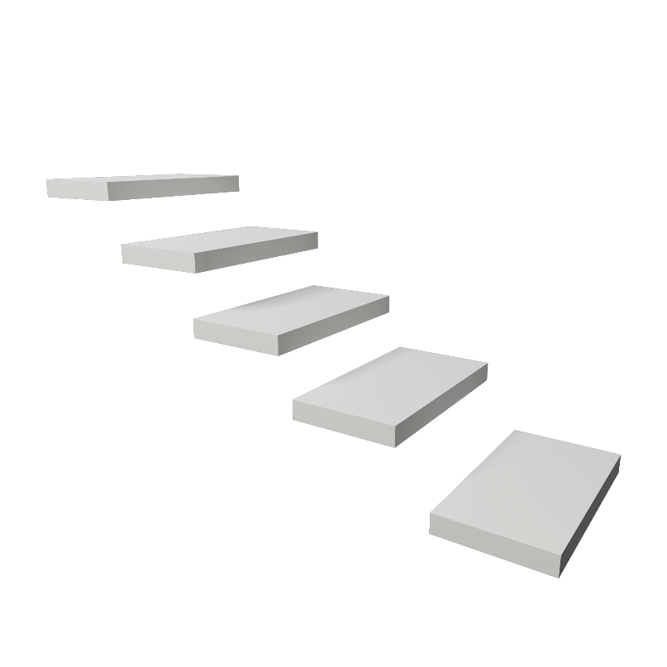
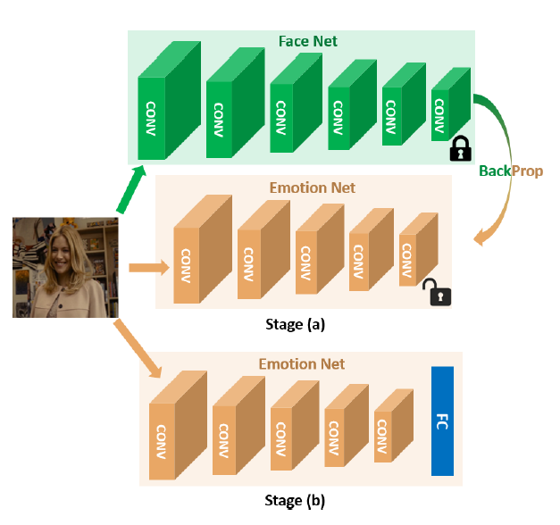
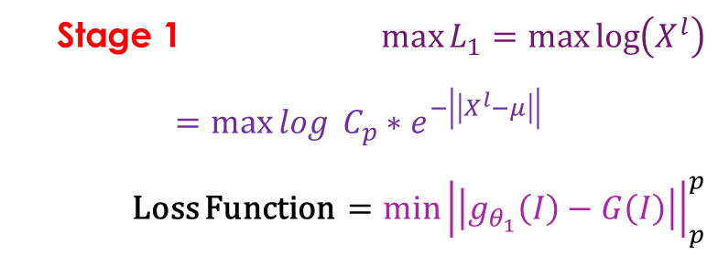
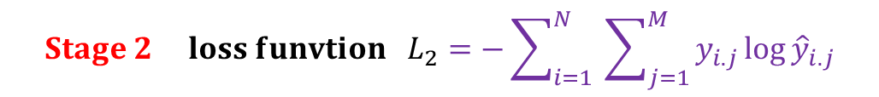
2 Stage Training
Stage 1 $\max{L_{1}=\max{\log\left(X^{l}\right)}}$
$$=\max{log} C_{p}∗e^{−\left|\left|X^{l}−μ\right|\right|}$$ Loss Function $={\min\left|\left|g_{θ_{1}}\left(I\right)−G\left(I\right)\right|\right|}_{p}^{p}$
$${Stage 2 loss funvtion L}_{2}=−\sum_{i=1}^{N}{ }\sum_{j=1}^{M}{y_{i.j}\log{{\hat{y}}_{i.j}}}$$

Slide 7
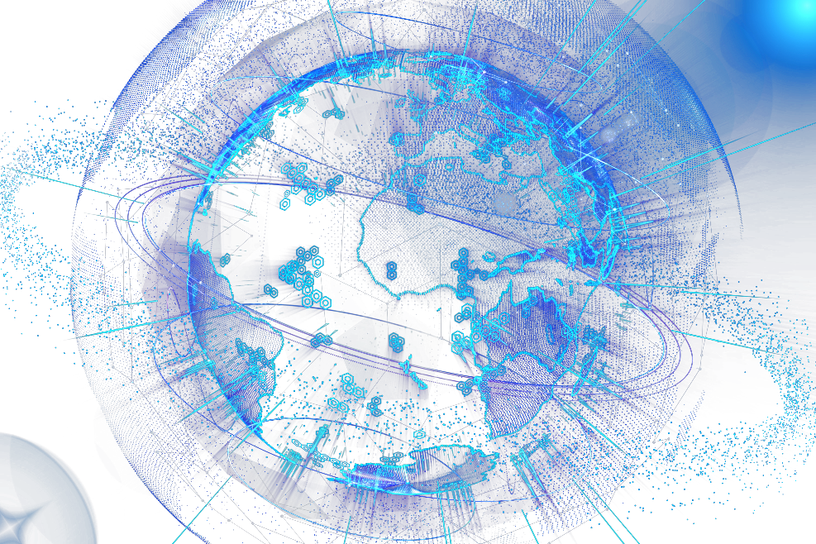
DataSet
Extended Cohn-Kanade(CK+)
Contains 593 Video Sequences from 123 subjects
Facial Shift from natural to target Expression
Total 7 Labels

Slide 8
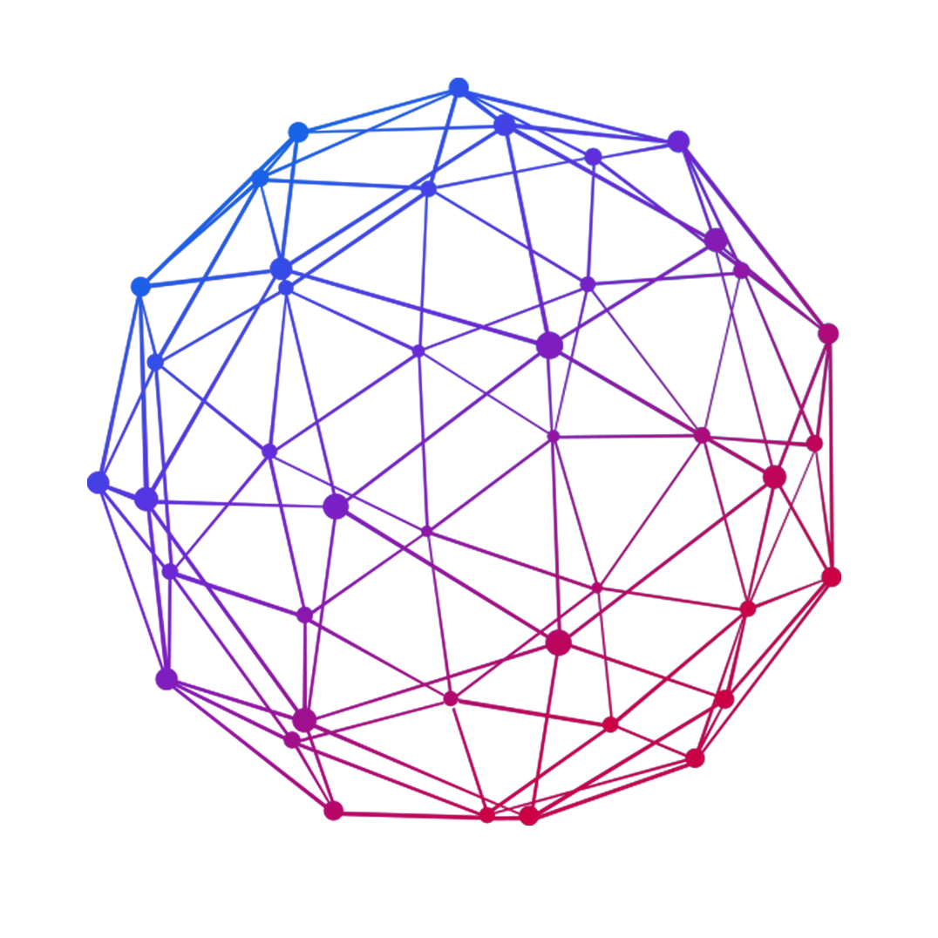
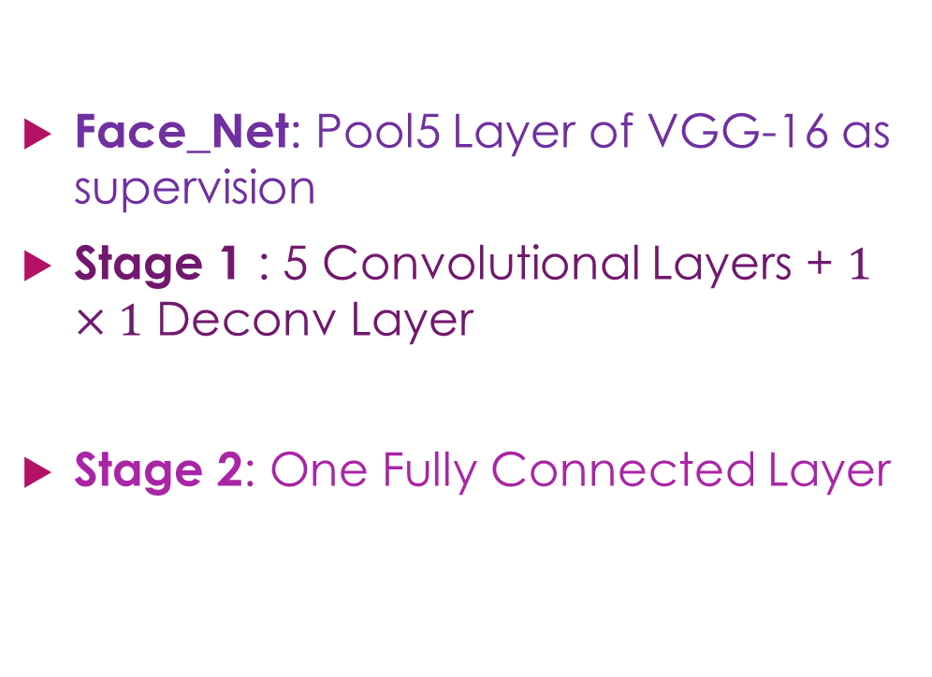
Networks Structure
Face_Net: Pool5 Layer of VGG-16 as supervision
Stage 1 : 5 Convolutional Layers + $1×1$ Deconv Layer
Stage 2: One Fully Connected Layer

Slide 9
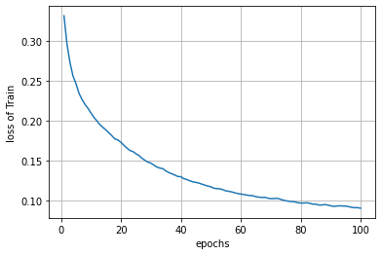
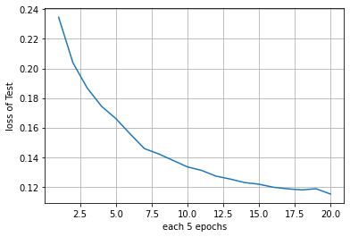
Results – Stage1

Slide 10
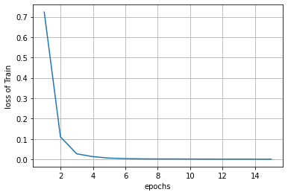
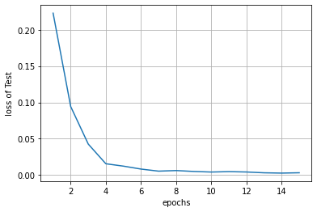
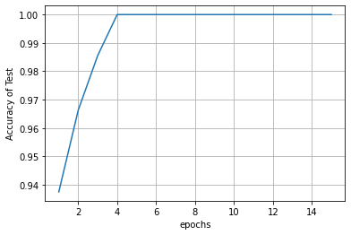
Results – Stage2

Slide 11

Some Suggestion for Improvement
Increase number of linear layer’s neurons to 512*8*8
Add more linear layer
Add more Convolutional layer

Slide 12
Thanks for your attention

